Slide 1
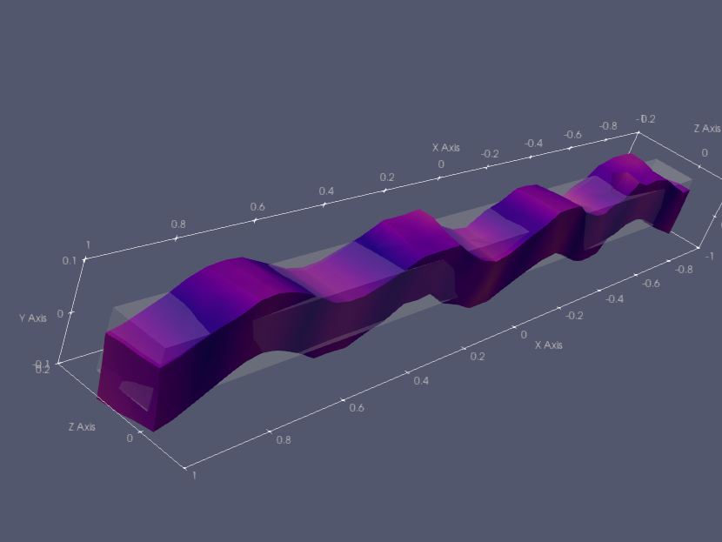
ParaView Workshop
Jonas Lindemann, LUNARC
Based in part on work and data sets by
Mike Bailey Oregon State University

Slide 2
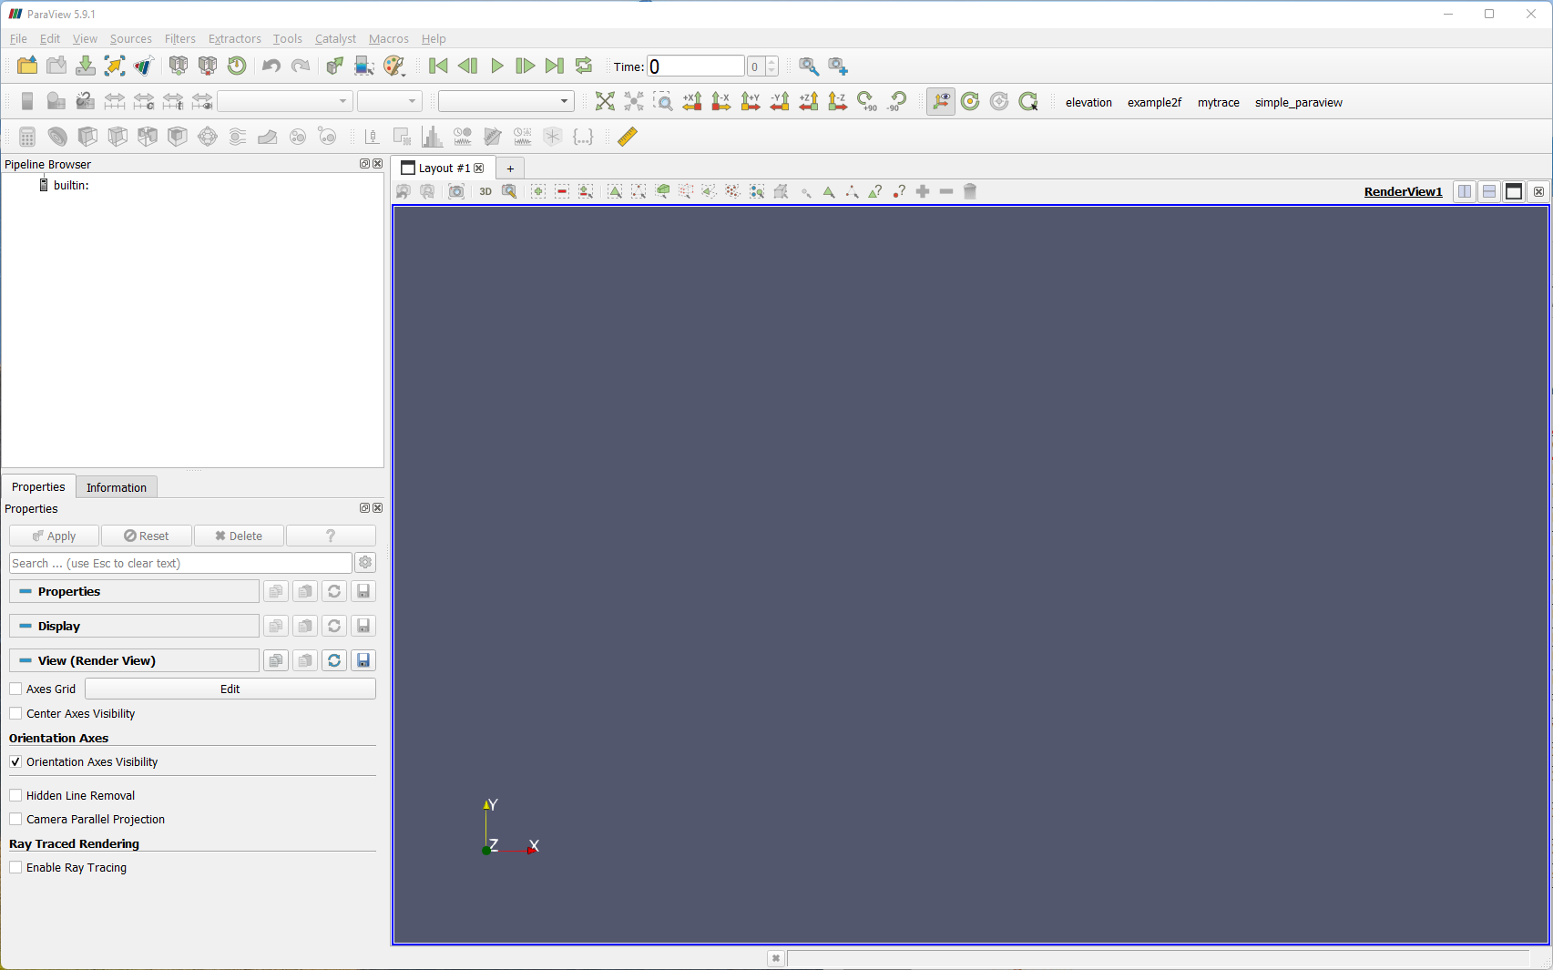
ParaView user interface
Reset visualisation
Animation control
Common filters
View control
Pipeline
Render View
Properties

Slide 3
Basic concept
Visualisation application developmed by KitWare
Uses the Visualisation ToolKit (VTK) as foundation
Uses a flow concept for generating visualisations
Source
Filter
Filter
View
Filter

Slide 4
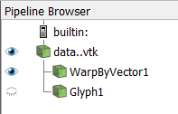
Flow in ParaView
Source data
Visibility of object
Filters

Slide 5
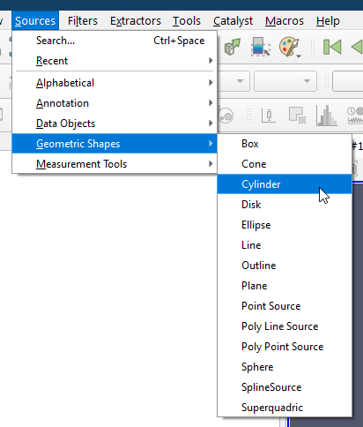
Basic usage – Creating a source

Slide 6
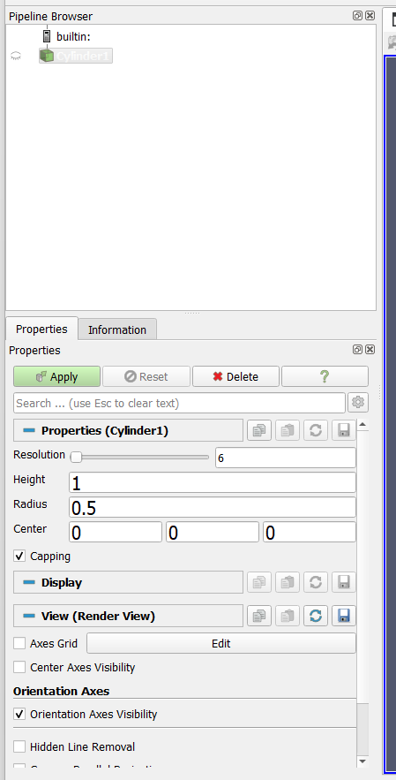
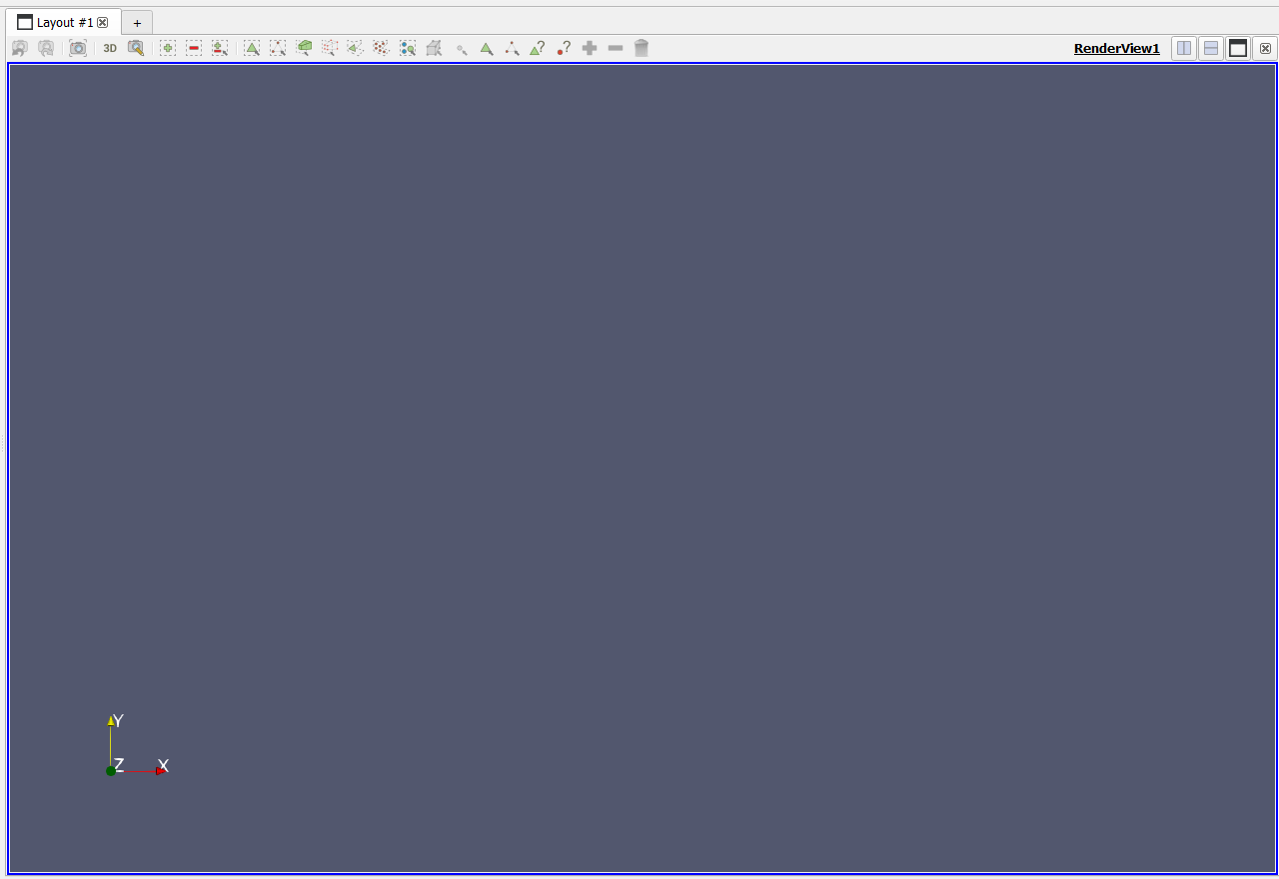
Creating a Cylinder
Cylinder source
Generate output
No output!

Slide 7
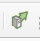
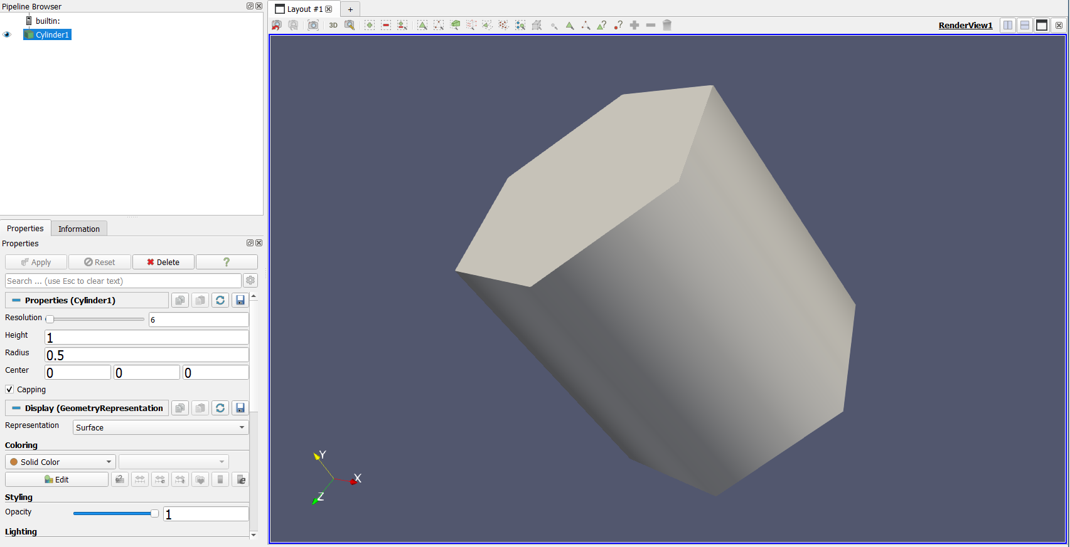
Creating a Cylinder
Enables auto-apply. Can be costly in some operations.
No visualisations are displayed until the Apply button is pressed.

Slide 8

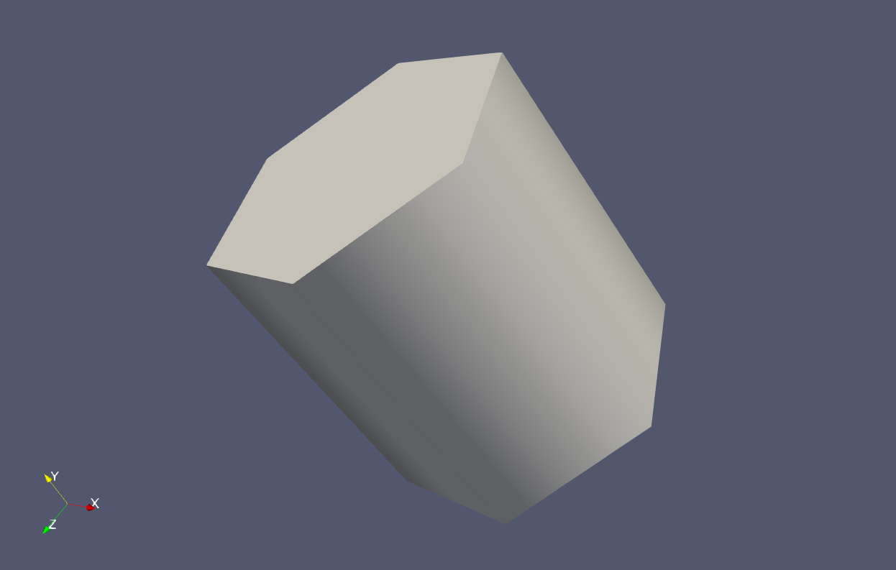
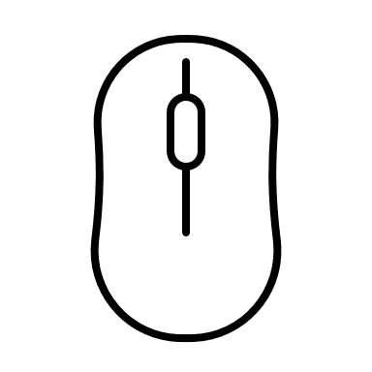
3D view manipulation
Rotate view

Slide 9
3D view manipulation
Shift
Roll view

Slide 10


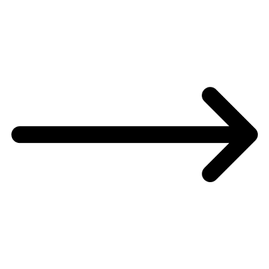

3D view manipulation
Pan

Slide 11

3D view manipulation
Zoom in / Zoom out

Slide 12
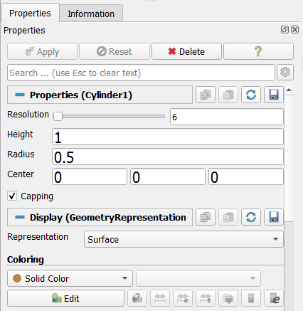
Specific object properties
All objects in ParaView have properties that can be changed in the property inspector.
For the Cylinder this is resolution, height, radius, capping.

Slide 13
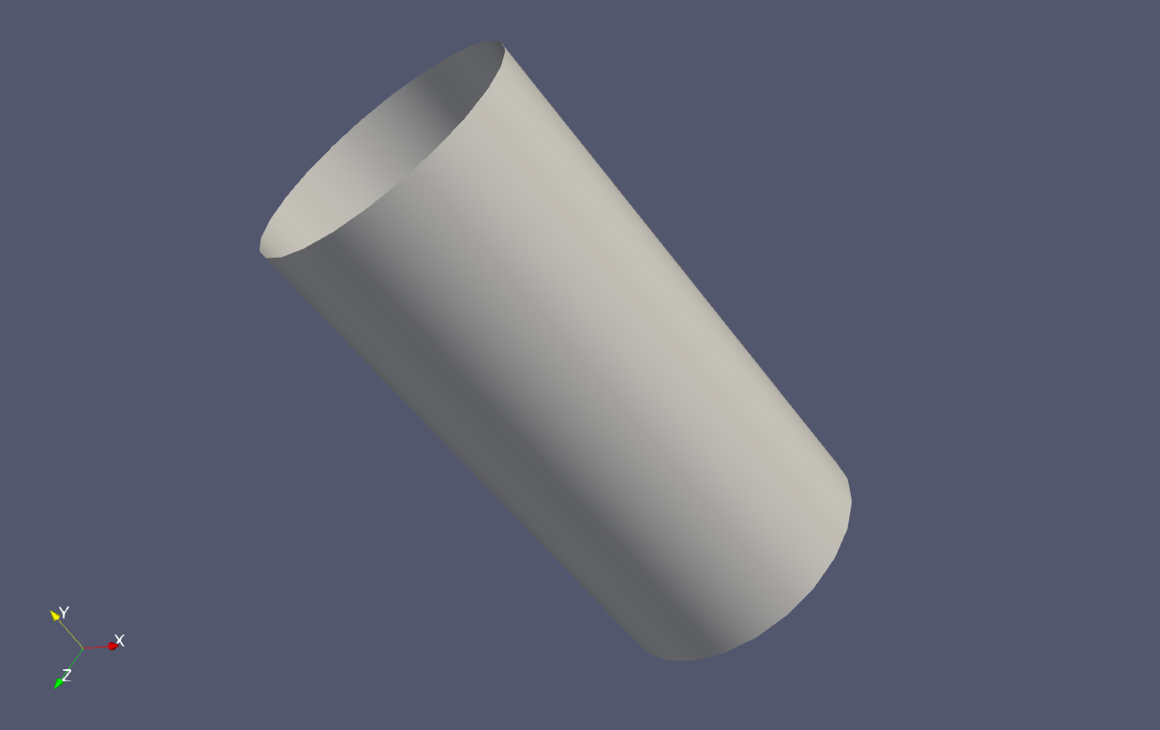
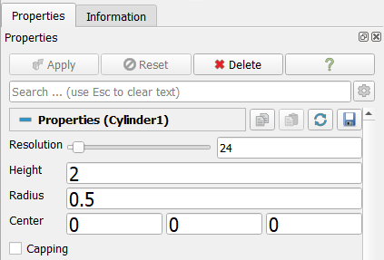
Specific object properties
Don’t forget to press apply after a change or use the auto-apply button

Slide 14
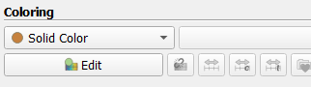
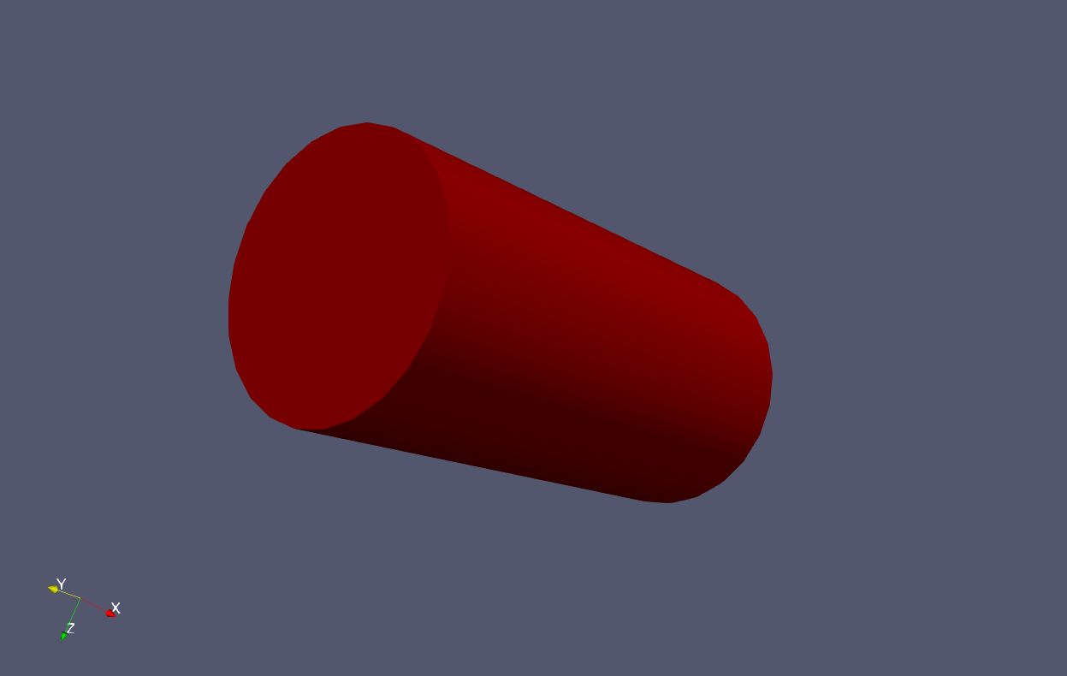
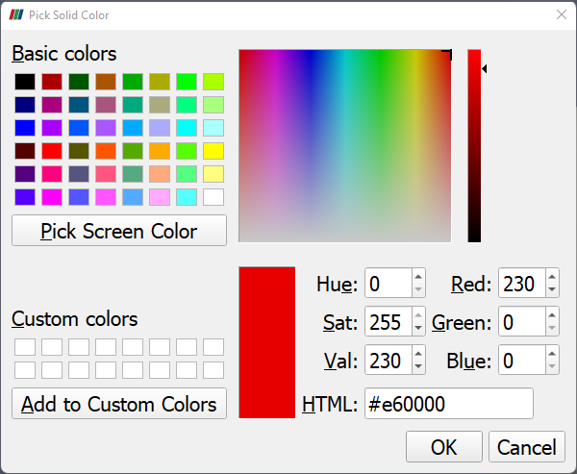
Color properties
All objects can be given colors either solid or by values / vectors

Slide 15
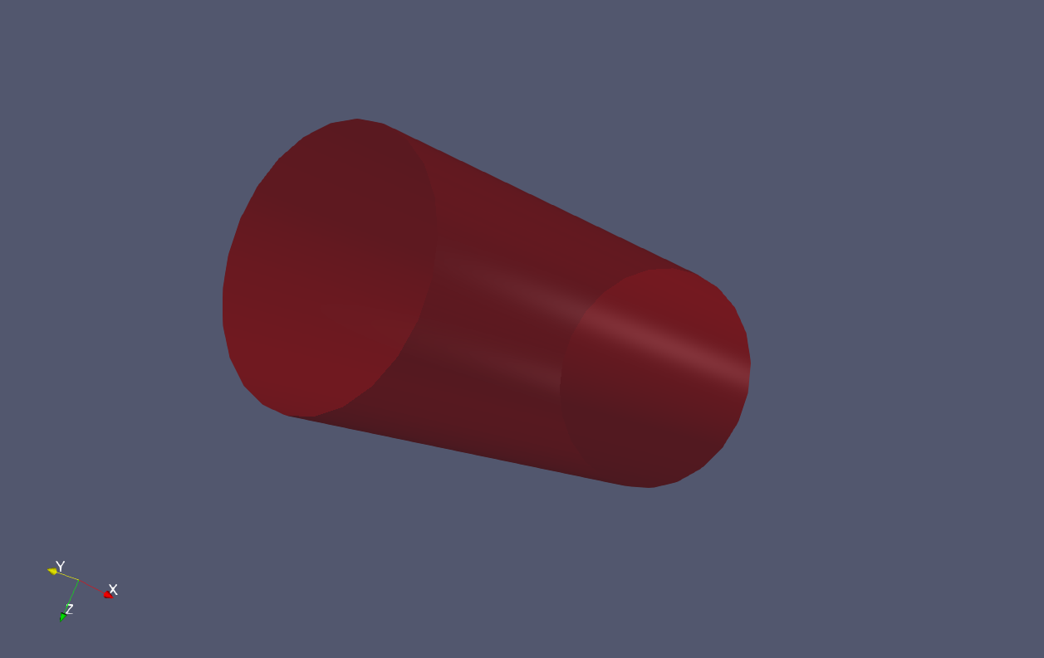
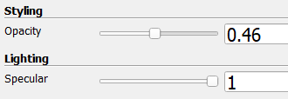
Material properties
Objects can also be given opacity and specular properties.
Specular controls how shiny an object is.
Opacity controls the transparency of an object. Can be useful to show outlines of objects.

Slide 16
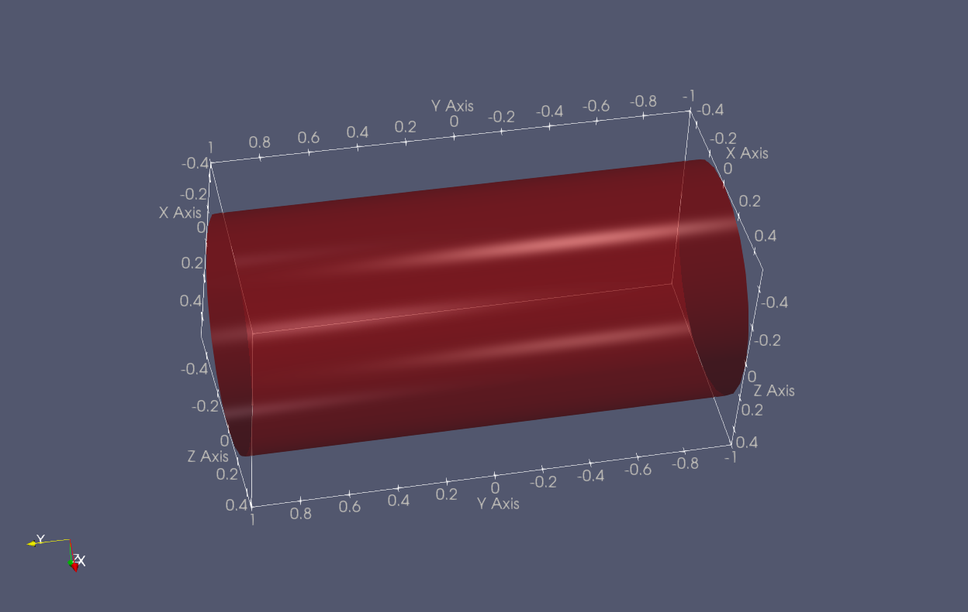
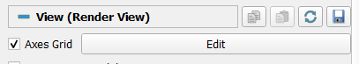
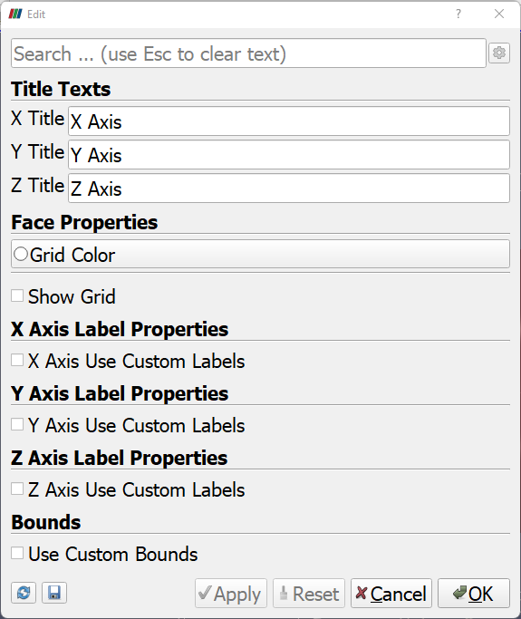
Axes
Axes can be used to give objects a sense of scale

Slide 17
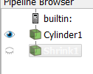
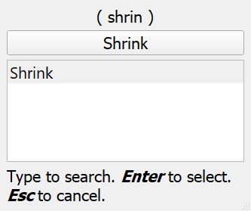
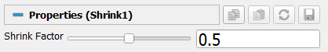
Applying a shrink filter
Click Filters / Search…
Type ”Shrink” in the search box
Press Enter or the button Shrink
Edit filter properties
Click Apply

Slide 18
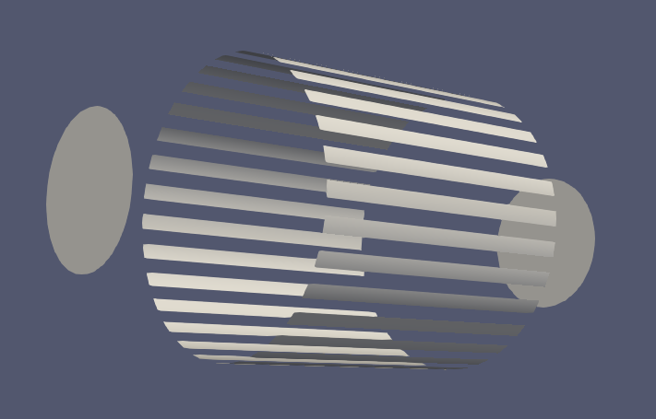
Applying a shrink filter
Colors, opacity and specular properties can be given for each separate object / filter

Slide 19
Demo time

Slide 20
Exercise
Create a yellow sphere with a radius of 3.0 and a theta and phi resolution of 32. Make the sphere really shiny!
Apply a shrink filter with a shrink factor of 0.8.
Color the shrinked sphere green. It should also be shiny.

Slide 21
Reading scalar data

Slide 22
Open the scalar.csv file
X32,Y32,Z32,S
-1.00,-1.00,-1.00,0.00
-0.94,-1.00,-1.00,0.00
-0.87,-1.00,-1.00,0.00
-0.81,-1.00,-1.00,0.00
-0.74,-1.00,-1.00,0.00
-0.68,-1.00,-1.00,0.00
-0.61,-1.00,-1.00,0.00
-0.55,-1.00,-1.00,0.00
-0.48,-1.00,-1.00,0.00
-0.42,-1.00,-1.00,0.00
-0.35,-1.00,-1.00,0.00
-0.29,-1.00,-1.00,0.00
-0.23,-1.00,-1.00,0.00
-0.16,-1.00,-1.00,0.00
-0.10,-1.00,-1.00,0.00
-0.03,-1.00,-1.00,0.00
0.03,-1.00,-1.00,0.00
0.10,-1.00,-1.00,0.00
File/Open…
Find the scalar.csv file.
Click Apply to load the file

Slide 23
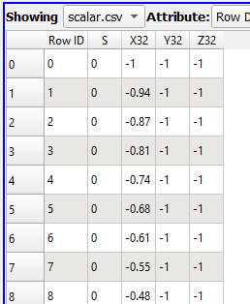
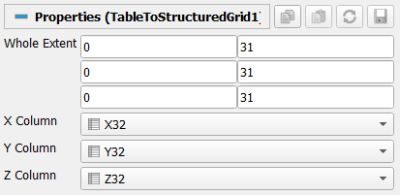
Reading CSV
We now need to translate this data into something that can be visualised with ParaView.
Todo this, we use the TableToStructureGrid filter.
Before applying the filter we need to define the structure of the data and where it can find the X, Y, Z coordinates in the files.

Slide 24
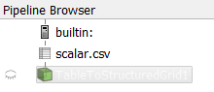
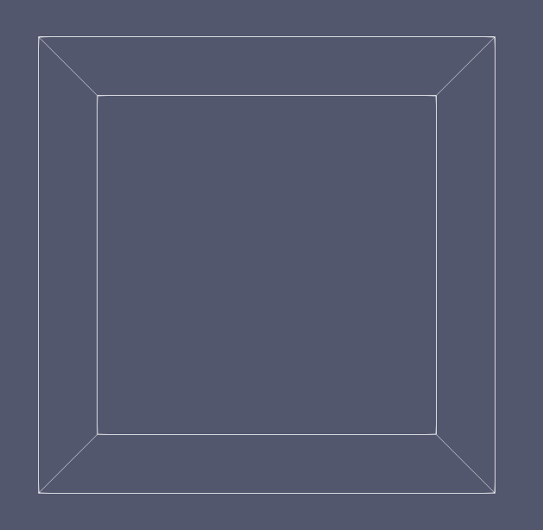
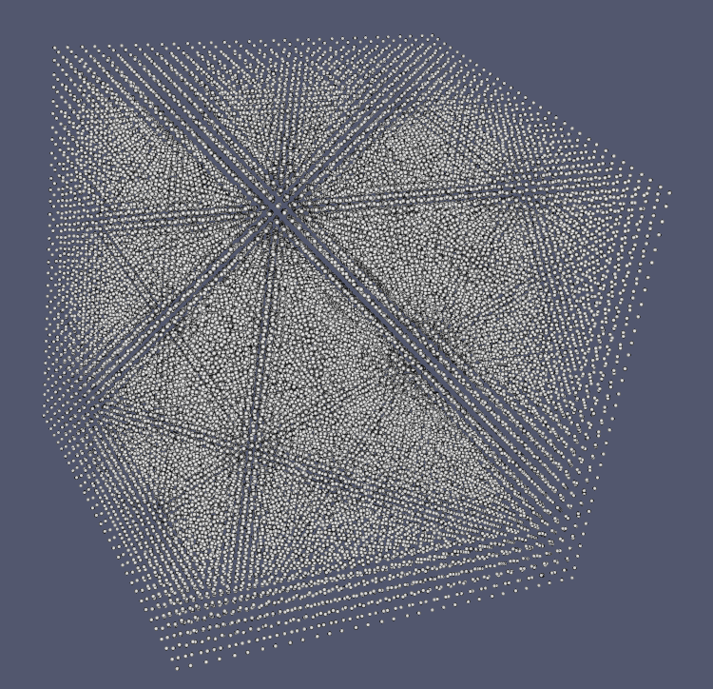
Visualising Scalar data
Click on the eye to display the data in the view.
Change the representation to Point Gaussian to display the values in the grid.
By default data is shown as an outline.

Slide 25
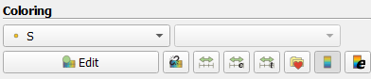
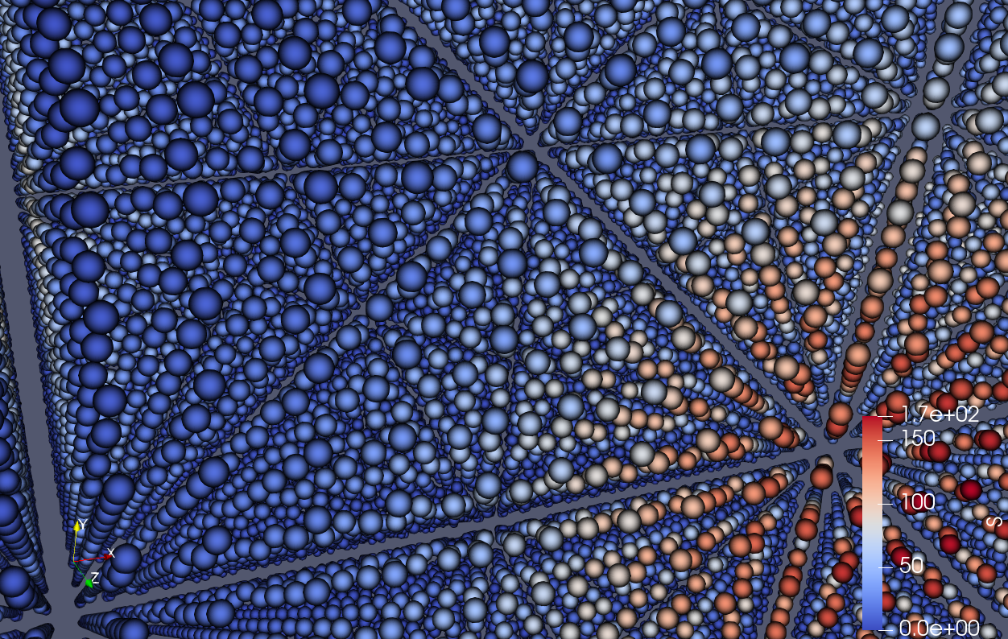
Displaying colors
The CSV file contained an S column of values. To display these using a color scale we need to select the data field in the Coloring section:

Slide 26
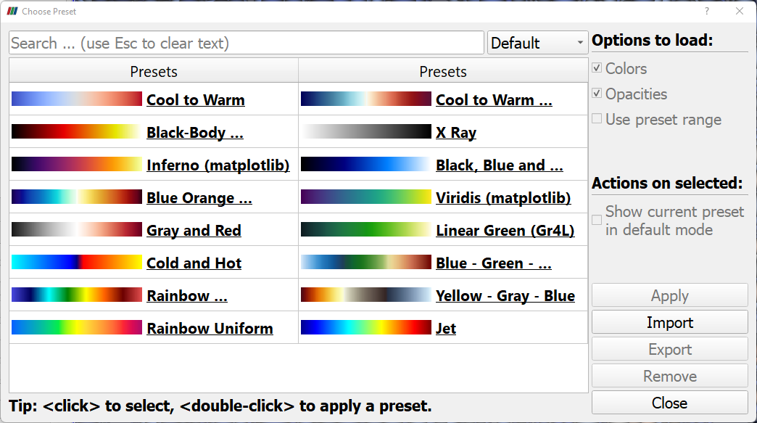
Changing color scale
Changing color scale can be done by selecting the folder with a heart.
A selection of color scales are displayed. Select a color map and click Apply to change.

Slide 27
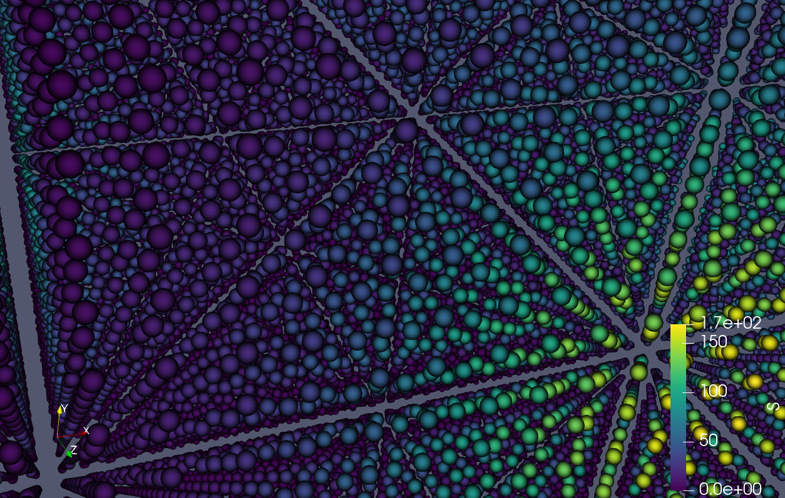
Changing color scale

Slide 28
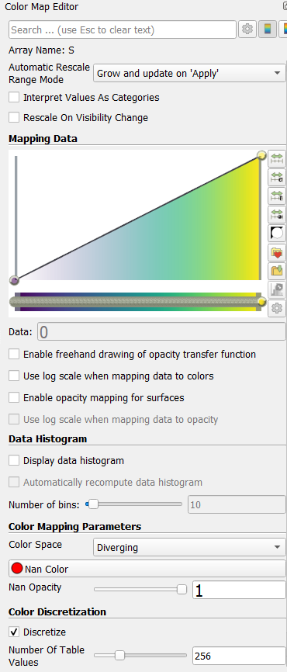
Changing color scale
The selected color scale can be edited by clicking the Edit button
Transparency transfer function
Color transfer function
A selection of color scales are displayed. Select a color map and click Apply to change.

Slide 29
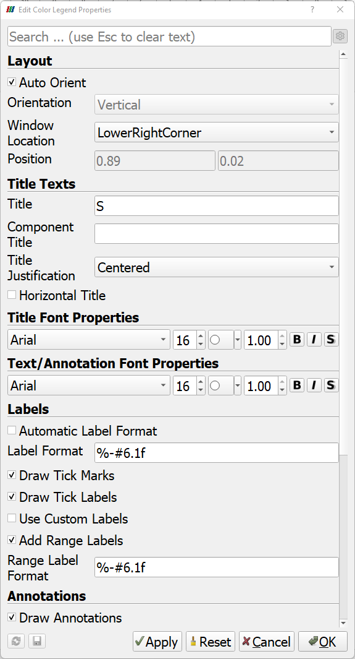
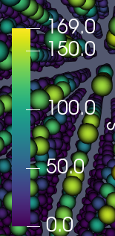
Changing the legend
Click the gear to show advanced options.
The color scale legend can be changed by selected the button with an e.
Setting the label format using format strings 6 characters wide with one decimal in fixed format.

Slide 30
Using filters with scalar data

Slide 31
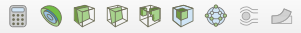
Common filters
Contour. Creates contour lines or surfaces.
Slice. Create a slice plane.
Threshold. Extracts data for a certain criteria
Glyph. Generate glyphs at data points
Warp by vector. Warps data mesh with a vector field
Calculator. Computes new fields based on existing fields.
Clip. Clips the data at a certain plane
Subset. Extracts a sub grid of the data
Stream tracer. Generate glyphs at data points

Slide 32
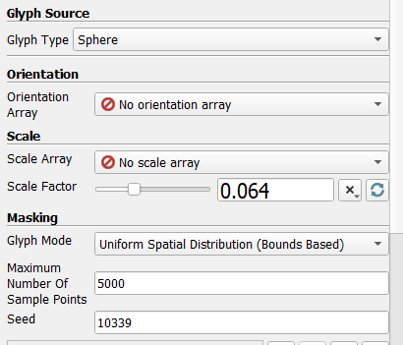
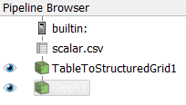
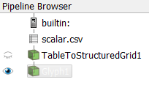
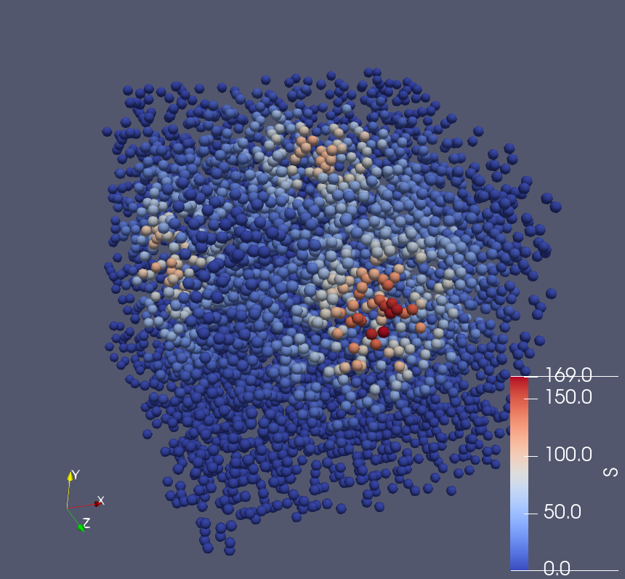
Glyph cloud
We need to turn off the TableToStructuredGrid

Slide 33
Exercise
Play with the parameters to see how it affects the visualisation.

Slide 34
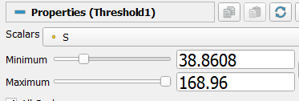
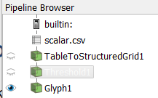
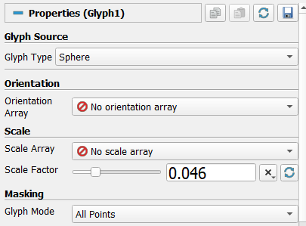
Tresholding data
We want to limit data in the glyph visualisation.
We Create the following pipeline
We use Delete to remote the existing filters and apply

Slide 35
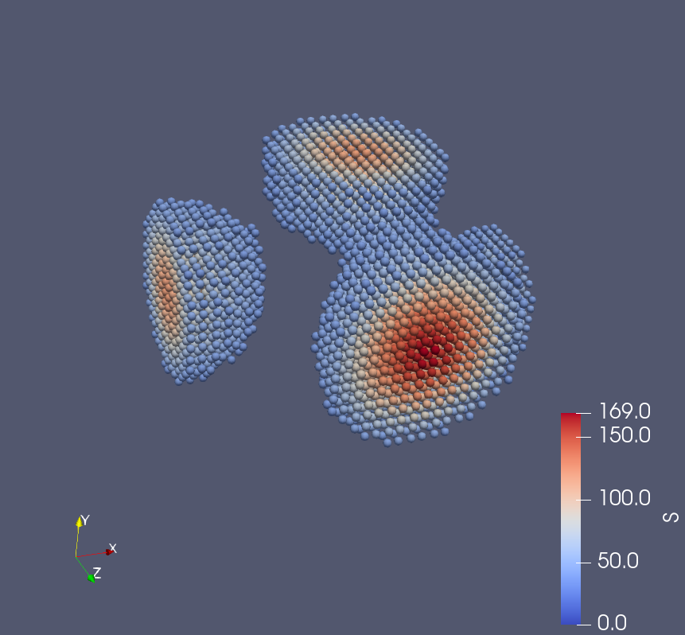
Thresholding data

